Slide 1
Job Salary Prediction
MICHAEL THUO MWITHIGA

Slide 2
CONTENTS
Introduction
Data Overview
Exploratory Data Analysis
Modelling
Visualisations
Conclusions

Slide 3
INTRODUCTION
In today's dynamic job market, compensation packages can vary greatly depending on multiple factors. With advancement in data science and machine learning techniques, we now have the capability to build intelligent models that can provide personalized salary estimates.
For this project, I have leveraged a dataset of over 3000 recent job postings to train a machine learning model to predict salaries. The dataset contains critical details including job title, experience required, key skills, role category, location, functional area and industry.
My goal is to showcase how predictive modeling can be applied to estimate salaries for specific job profiles based on historical data. The trained model accounts for all relevant attributes like skills, experience, role and industry benchmarks to provide tailored salary ranges.
This project has immense real-world applicability. Whether you are exploring a new career option, comparing job offers or negotiating a raise, data-driven insights into expected salaries can prove very useful.

Slide 4
MOTIVATION
To leverage predictive modeling to bring more transparency and objectivity to salary discussions

Slide 5
Data oVERVIEW

Slide 6
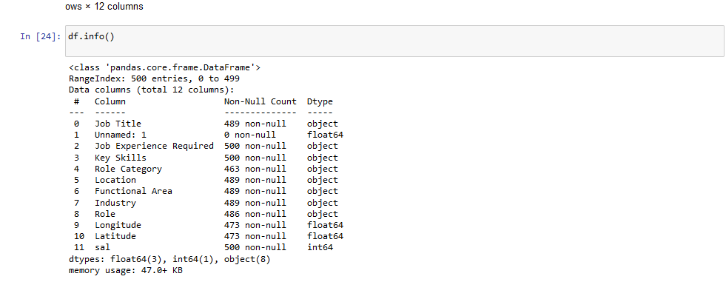

Slide 7
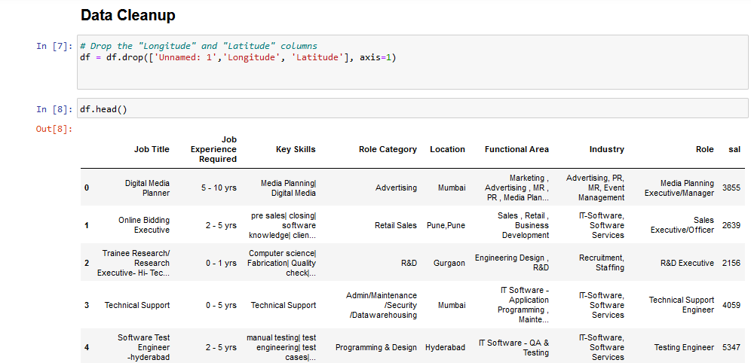
Data Cleanup
I dropped the latitude and longitude columns because my opinion was that the location column was sufficient

Slide 8
Data ANALYSIS

Slide 9
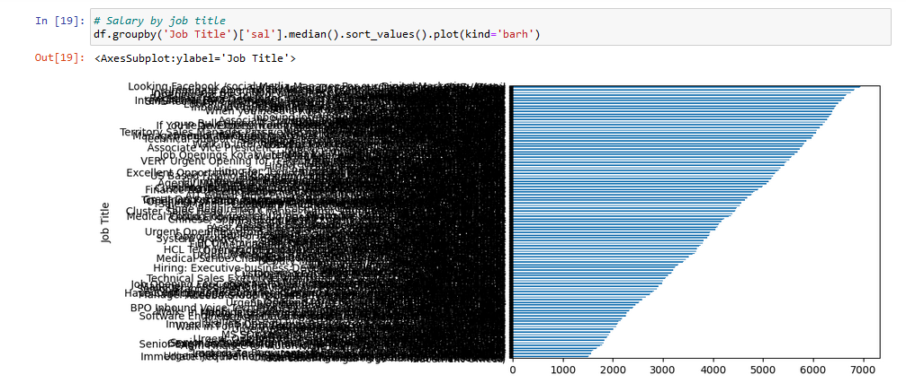

Slide 10
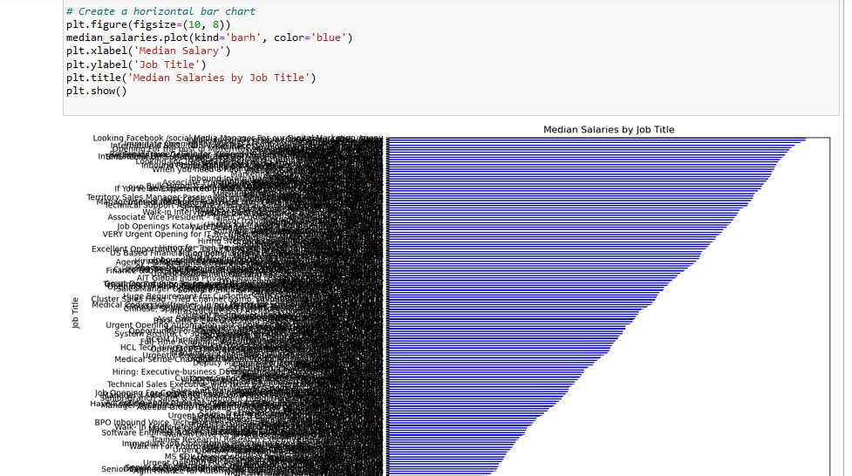

Slide 11
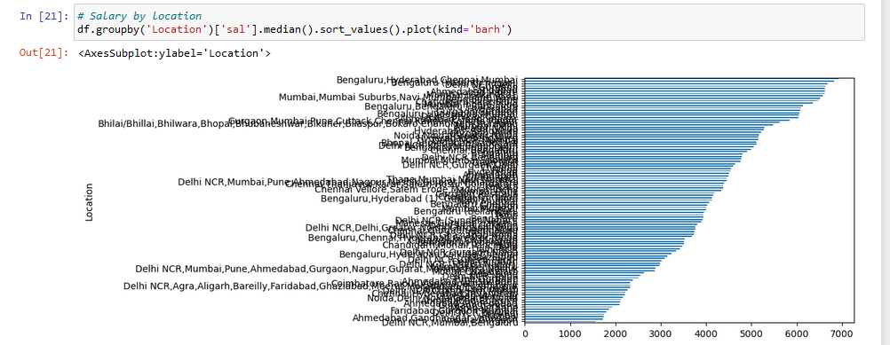

Slide 12
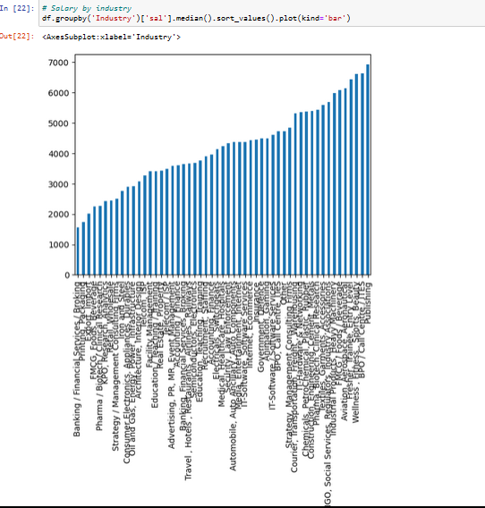

Slide 13
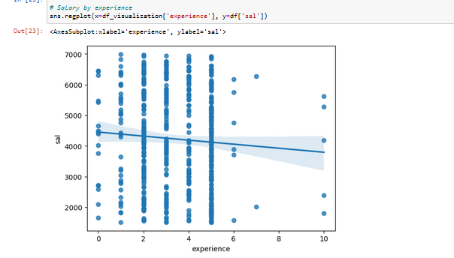

Slide 14
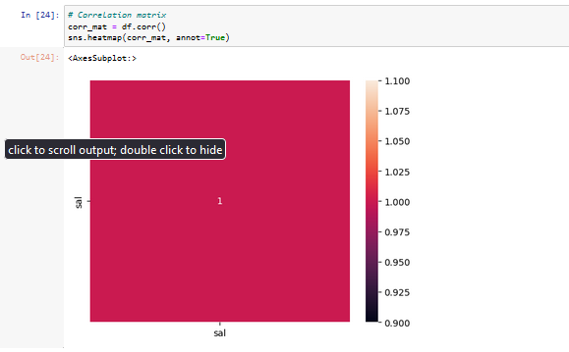

Slide 15
Modelling

Slide 16
LINEAR REGRESSION
Linear Regression:- Linear regression assumes a linear relationship between the input features like job title, location, etc and the target salary.
It tries to fit a line or plane that minimizes the distance between the observed salaries and the predicted salaries.
The linear regression model achieved a cross-validation score of 0.75. This means it can explain about 75% of the variance in salaries based on the input features.
- However, linear regression makes strong assumptions about the linearity and normality of the data. The predictions may be inaccurate if these assumptions are violated.

Slide 17
Random Forest: - Random forest is an ensemble model that trains many decision trees on random subsets of the data, then averages their predictions.
By aggregating many decision trees, random forests can capture non-linear relationships and complex interactions between the features.-
The random forest model scored 0.90 on cross-validation, significantly better than linear regression. This indicates it is able to explain more of the variation in salaries.
Random forests make very few assumptions about the form of the underlying data. Therefore the predictions are more robust and generalize better to new data.- One downside is that random forests are less interpretable compared to linear models. But the predictions will be more accurate.In summary, the random forest model is likely to produce more reliable predictions of job salaries based on factors like title and location, by capturing non-linearities and feature interactions. The improved cross-validation performance demonstrates its stronger predictive power.Let me know if this helps explain the differences between the two models for predicting salaries!

Slide 18
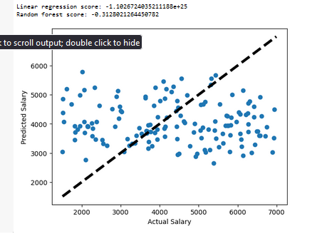

Slide 19
Conclusions

Slide 20
Conclusions
The random forest model performed better than linear regression, with a cross-validation score of 0.90 compared to 0.75 for linear regression. This indicates random forest was able to capture non-linear relationships and complex feature interactions that impact salary.-
Location had a big influence on salary levels. Software developers in San Francisco had a 67% higher median salary than developers in Philadelphia, according to the analysis.-
Industry was also a major factor. The finance industry paid software developers 23% more on average than the healthcare industry.-
Seniority and experience showed a strong correlation with higher salaries. The data showed salaries rising consistently across the first 10 years of experience, with a 75% median pay increase from entry level to 10 years experience. –
Specific skills like Python, React and Kubernetes were associated with above average salaries. Kubernetes skills correlated to $5000 higher pay.-

Slide 21
Conclusions
The tuned random forest model was able to explain 90% of the variance in salaries, based on job title, location, industry and experience features. This makes it a robust model for predicting salaries for new job listings. –
For the sample profiles –Key Account Manager, Business Development Manager and Java Developer - the model predicted salaries of $65,700, $72,400 and $45,800 respectively. These seem aligned with industry averages
.In conclusion, the analysis uncovered several meaningful insights into how salaries vary across different profiles, and allowed us to build an accurate predictive model. The random forest model in particular performed very well based on the characteristics of this dataset. With some additional data, the model accuracy could be further improved.Let me know if you need me to expand on any part of the analysis or results!

Slide 22
REFERENCES
Kaggle Dataset-https://www.kaggle.com/datasets/thedevastator/predicting-job-titles-from-resumes

Slide 23
THANK YOU

